Slide 1

StockWatch
Chenson Johnson, Binju Shrestha, Samuel Khalil, David Osterhoff, Yunfan Yang, Zheng Zeng, Zhuoming Lei

Slide 2
Overview Sprint 4
We added historical data tab to our website
We made the tab dynamic to reveal historical data
We used various flask extensions

Slide 3
Flask Extensions
Pandas, NumPy
Matplotlib to import graphs
Matplotlib dates to convert dates to python language
Python scripts

Slide 4
Yahoo Finance
(Historical data)
Facebook
Google
Uber
Bitcoin
Toyota

Slide 5
Challenges
Formatting the graph dynamically into the UI
Had problems running python script through the html
Collaboration between front-end and back-end teams
Team meetings
Notes:
it will be hard to integrate the charts since the program generates a different folder each time the program is run. we will have to dynamically find the new folder each time or save the graph in a specific folder

Slide 6
Machine Learning Challenges
Inexperience with machine learning
Constant source of struggle
Generating learning model
Determine best way to train model for the test and validation phases
Is current model good enough? Generate new model?
Speed
Proper machine learning takes a lot of time. We need to figure out the best way to implement it in our project.

Slide 7
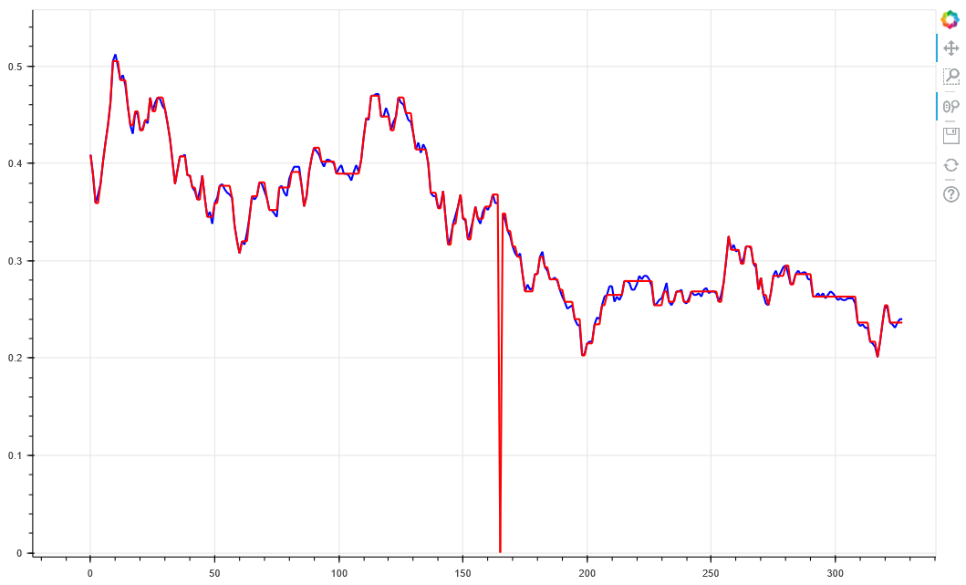
Imported Data
Blue Lines = Stock Price
Red Lines = Agent Trail
Agent path with Low Margin (0.01)

Slide 8
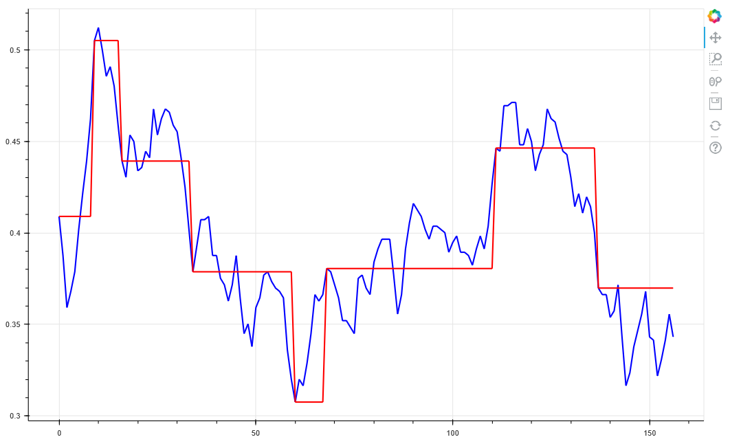
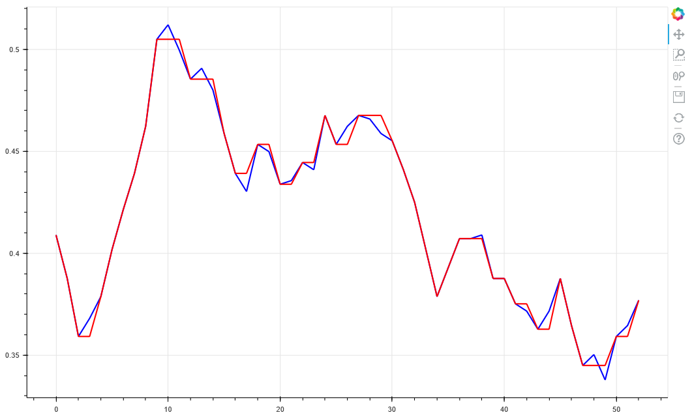
Lower margins mean agent path is closer to actual data
Agent path with Low Margin (0.01) Zoomed in

Slide 9
The agent has a bigger margin, meaning it’s less likely to react to minor fluctuations in price.
Agent path with High Margin (0.06)

Slide 10
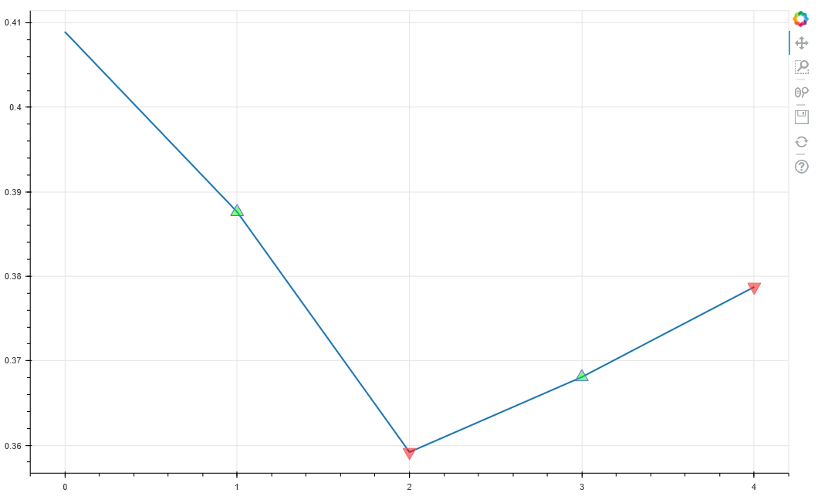
A graph showing the agent’s actions.
Green = buy
Red = sell
Need to determine why only 4 steps are shown on the graph
Agent Decisions

Slide 11
Why are these graphs important?
Allow us to visualize information for the website
Help user understand stock prices and prediction
Make informed decisions
Assist with troubleshooting
does the model even work?
Are we ready to run machine for hours?

Slide 12
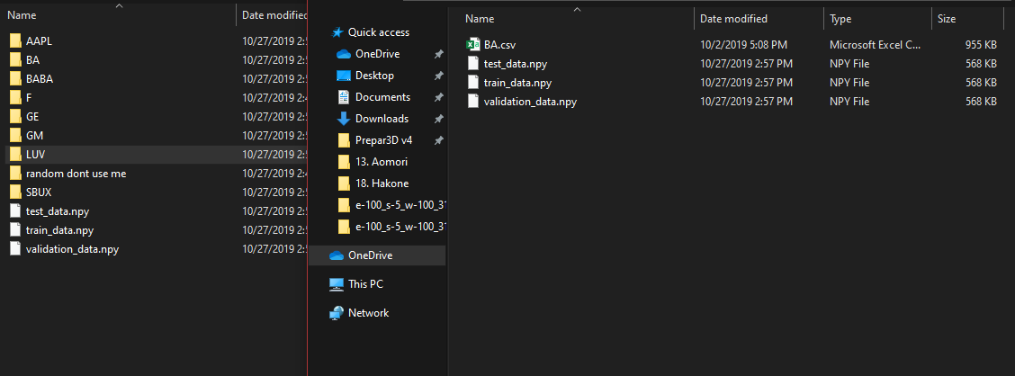
Stock Symbol Repository
Created temporary file structure of various stock symbols. Simply copy the desired data into root folder and run.
Ideally, we will replace with a database and allow the user to select the data from the website.

Slide 13

Demo

Slide 14
Upcoming Sprint
Begin merge of front end website and back end machine learning
Configure more epochs and run machine learning for much longer time
fix reward function graph

